Slide 1

Shifting Left <<
<Presentation-1>
<< Infrastructure as code with Bicep and Azure
Part 1 – An introduction to using Bicep
Part 2 – Integrating Bicep with Azure DevOps
Notes:
Shifting Left << Infrastructure as code with Bicep and Azure
This talk became too long to complete in one sitting so has been broken into two parts.

Slide 2


Intro
Who am I?
Jon Baggaley (@WorthingCoder) / Twitter
linkedin.com/in/jonathan-baggaley/
Code & slides
github.com/zebslc/bicep-talk-2023
Notes:
Some information about me
Jon Baggaley (@WorthingCoder) / Twitter
Jonathan Baggaley | LinkedIn
Code & slides
zebslc/bicep-talk-2023: A collection of files and slides from my talk about Bicep and shifting left with infrastructure as code (github.com)

Slide 3

What am I going to talk about?
What is shifting left?
The joy of being manual
What is Bicep and how do we use it?
Proving what you have done
Demonstration
How to get started
Best practices

Slide 4
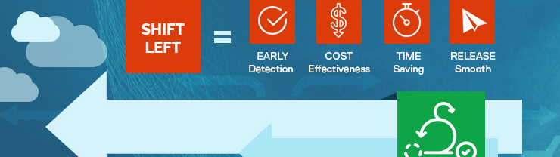
What is shifting left?
Definition
What does it enable
What problems does it solve
Notes:
Shifting Left
Shifting left is all about moving risk to the earliest point we can in our delivery cycle. It means we have more chance to identify risks and problems before they reach the customer/our clients.
Other examples of Shifting Left include Automated Testing as well as security improvements such as penetration testing and using devop tools that perform checks on our open source packages.
This biggest problem it solves is that of quality. Increasing quality to make our systems more robust and less prone to attacks also affects our reputation and corporate bottom line as we are less likely to suffer outages or data breaches.

Slide 5
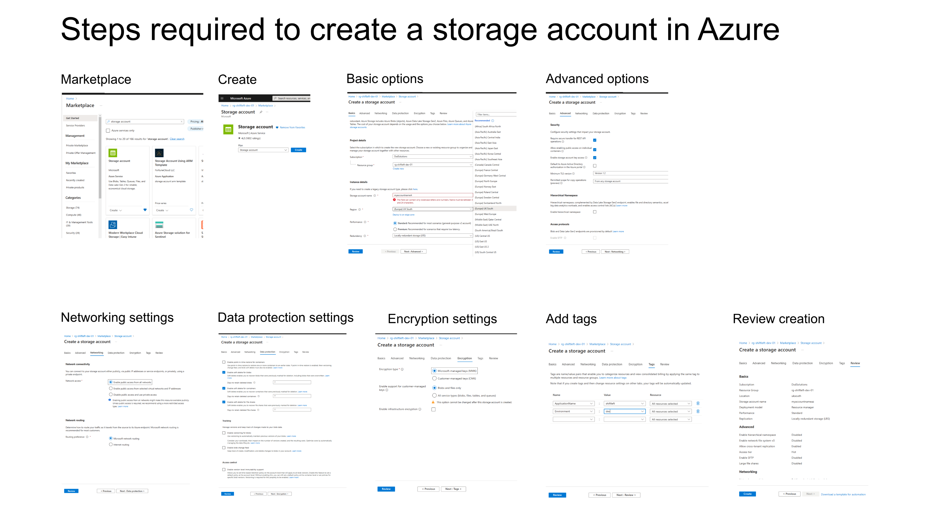
Notes:
In the slide you can see the many steps required to just create a storage resource manually using the Azure portal. With so many settings it is really easy to miss something or requires a much higher standard of documentation to make it reproducible for the next storage resource we wish to create.

Slide 6
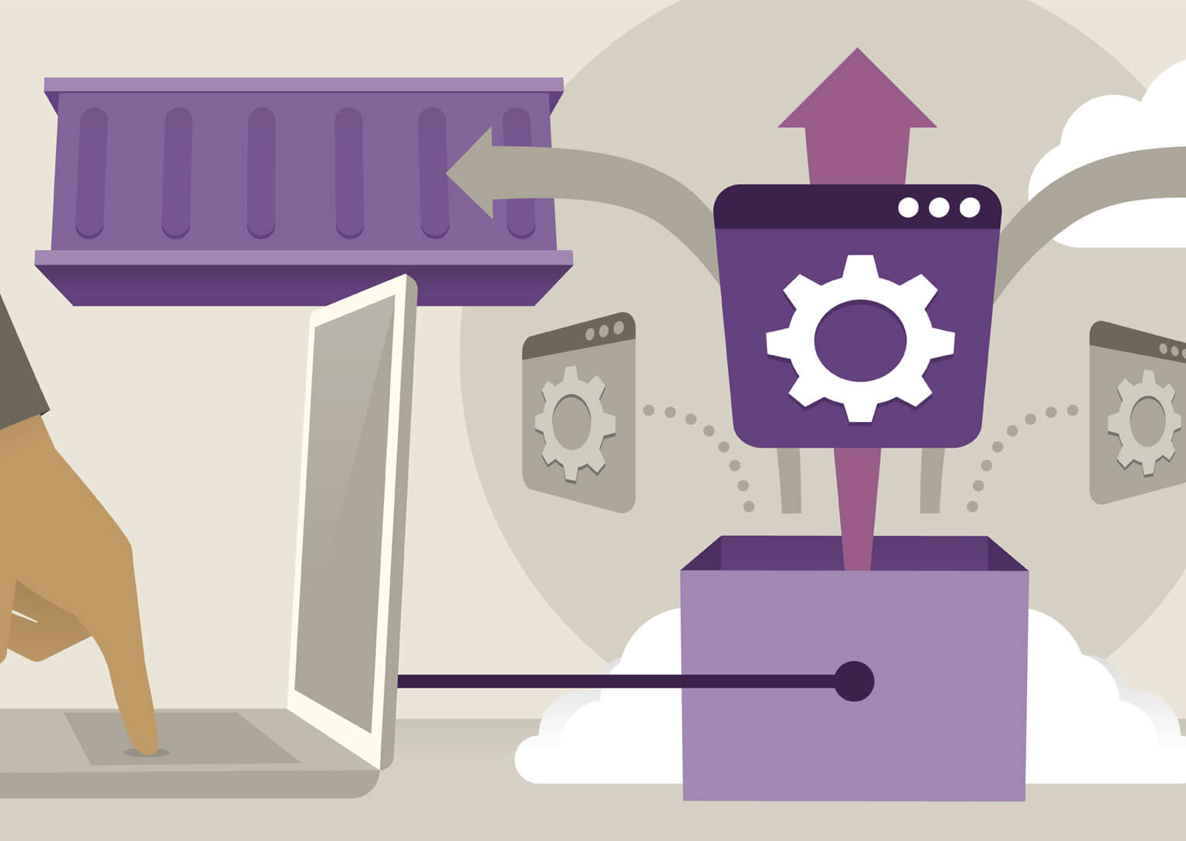
The joy of being manual
The risks
The benefits
Infrastructure as code to the rescue
Notes:
The risks
Making mistakes due to complexity
Repeating the same thing in multiple environments
Misconfiguring and opening up to errors
Tedious
Ghost resources
The benefits
Easy for ad-hoc changes
Visual interface to see changes
Infrastructure as Code
This has become an essential part of any software development process with the introduction of CI/CD
It treats infrastructure as we do code, so it is subject to the same versioning, pull requests and other quality processes
It gives us a chance to get additional eyes on whatever we are deploying in order to spot any obvious things wrong – something that is incredibly difficult if we are trying to review the contents of our resources in Azure portal
Creating a new environment is just a case of running the script with different parameters which de-risks setting up for different use case scenarios and makes them possible in a small timeframe
If a vulnerability is discovered in our environment through penetration testing or hacking, we can really quickly patch it and know it is fixed on all our environments
We can easily audit out infrastructure for compliance reporting such as PCI as everything is known and uses correct naming standards.
This also gives us auditing of what changed, why and when which can be useful when doing forensics of an attack
It removes the weakest point of the chain – humans from manually setting things up and getting them wrong

Slide 7


What is Bicep & how do we use it?
Definition
Benefits
Tooling
Notes:
Bicep is an open source Domain-Specific Language developed by Microsoft that compiles to Azure Resource Manager (ARM) templates.
It has a simplified syntax for writing easily maintained Azure resource templates which also means they are easier to read and verify. It is intended to be idempotent which means it can be run again and again and always produce the same result.
There are two modes for running scripts, incremental (the default) and complete which deletes anything not in the script. There are plans to remove complete and convert it into deployment sets however.
As a language it is a cross between C# and Powershell. All commands run at the same time for speed, though you can set dependencies on resources being created.
It can integrate with Powershell as part of the script giving it the power to do anything Powershell can do.
You can create bicep scripts in any tool you like – including notepad as they are just simple textfiles however there has been a significant investment in VS Code and the Bicep extension. That features built in Linting/validation and pre-flight checks before it submits your code to ARM for deployment.
The VSCode extension can even convert ARM templates taken from the Azure Portal into Bicep format to act as a starting point for writing your scripts.

Slide 8
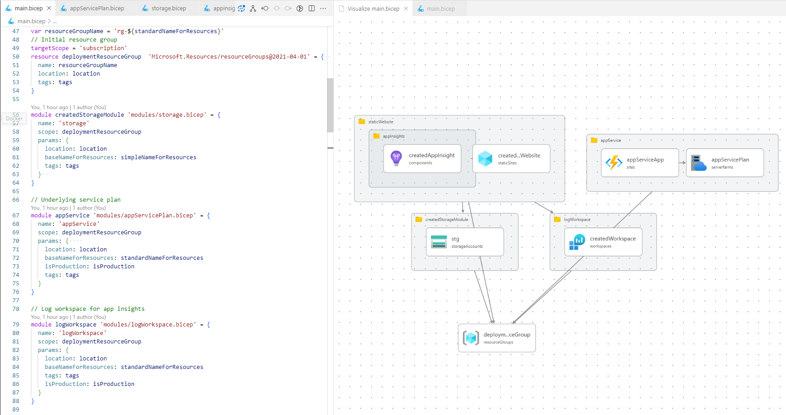
Auto Preview
Notes:
Here is an example of VS Code creating an automatic preview of the script you are creating which can then be compared to a network diagram to ensure you are building the correct thing or stimulate conversation about potential holes

Slide 9

Proving what you have done
Built in checking / proofing
PR checks
Running the scripts manually
Validating your design with AI
Notes:
Built in checking / proofing
We can build it but is it right?
Create a network diagram using PlantUML which you keep updated with all the changes you add in so pull requests are meaningful (also works in vscode)
Plant ULM - nwdiag (plantuml.com)
PR checks
Code should be readable to other developers.
Use of preview mode to compare against a desired network diagram
Modularise as much as possible to promote reuse and aid readability.
Test creating your project in a disposable area and look at all it has created – does it match what you have in your diagram?
What is the best way to examine a network design for scaling and security?
Hire a network engineer/show your networking team
Run your plantUML diagram through chatGPT or similar and ask it to point out security risks/vulnerabilities. It can usually understand the code though not as well as a competent network engineer

Slide 10
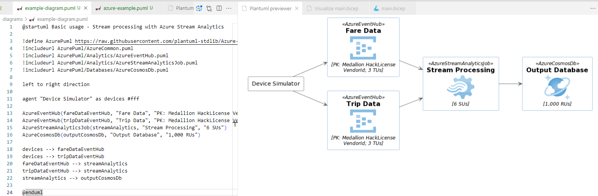
Demonstration overview
Bicep within VS Code
How preview works
Resources being created from the command line
How to use PlantUML
Notes:
Use the following commands from within VS Code terminal to generate the environment set up in the git repo. Note, everything has been set up to be on the free/cheap tiers by default but you are responsible for deleting your resources after use (you can always easily recreate them)
This assumes you have your terminal set to the same folder as “main.bicep” and have installed the bicep extensions. Look at the code first so you can understand what it is doing. The CreateB2C flag can only be set to true once because the b2c tenant can only be set up once so change that to false after you run it successfully the first time.
az account set --subscription {get your subscription from Azure Portal here}
az deployment sub create --location uksouth --template-file main.bicep --parameters location=uksouth baseApplicationName=shiftleft environmentName=dev environmentNumber=1 countryCode=GB createB2C=true
Once you have created this environment, open Azure Portal and look at the resource group created. Click on the [Access Control IAM] menu. The click add role assignment, set the admin super user to your login account and also set the key vault administrator to your login account so you can see the keys created

Slide 11

How do I get started?
Simply!
learn.microsoft.com/
ChatGPT / Bing
Notes:
https://learn.microsoft.com/en-us/events/learn-events/learnlive-iac-and-bicep/
Learn Live: Use Bicep to deploy your Azure infrastructure as code - Events | Microsoft Learn
https://ochzhen.com/blog/azure-bicep-modules
You can start with just a single module or use the code sample created as a basis for your own environment. In my previous organisation, we had 20+ azure serverless functions, database, b2c etc. The script allows you to easily set up multiples by just adding them in the Functions.bicep file.
There are lots of improvements that could be added to the git repo so feel free to create a PR of suggestions of things you think would help other people learn. In many of the files I have added links to the official resource documentation for ease of reference.
If you are completely stuck, try choosing all the things you want in the Azure pricing calculator, download the spreadsheet, choose the first 4 columns (not the price) and paste it into chatGPT with code comments (```) then ask it to generate a bicep script from that. What it generates will not be directly runnable at this point in time but gives a great starting point for your own script.
Bicep can be highly frustrating at times as can any other technology but with patience (and possibly some Powershell), you should be able to do most of the things you need.
I found the following resources handy:-
https://ochzhen.com/blog/azure-bicep-modules
Learn Live: Use Bicep to deploy your Azure infrastructure as code - Events | Microsoft Learn
https://learn.microsoft.com/en-us/events/learn-events/learnlive-iac-and-bicep/

Slide 12

Best practices
Naming conventions
Use of restrictions in your modules
@Description()
Pre-written modules
Notes:
Naming conventions can be found here:-
- https://learn.microsoft.com/en-us/azure/cloud-adoption-framework/ready/azure-best-practices/resource-abbreviations
You will see examples of restrictions in the git sample main.bicep file. For readability I only added them at the top level because the modules cannot be called without going through that and it makes the modules more generic
Document your parameters with @Description and ideally include an example to make it easier for someone else to know how to run it
There are a number of pre-written modules available such as the ones listed below. They can be a little generic. I have listed three of the main ones below:-
azure-quickstart-templates/main.bicep at master · Azure/azure-quickstart-templates (github.com)
azure-docs-bicep-samples/samples at main · Azure/azure-docs-bicep-samples (github.com)
AzureDeploymentFramework/ADF/bicep at main · brwilkinson/AzureDeploymentFramework (github.com)

Slide 13

Questions?
Message me on twitter or linked in

Slide 14
</Presentation-1>
Notes:
Thank you for reading & have fun playing with the sample ☺

